Slide 1
Supervised Method Process
By: 2/c Matt Varney and 2/c Will Sergio

Slide 2
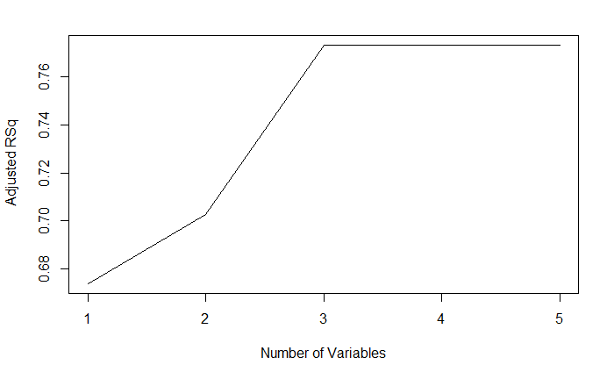
Best Subset Selection
Interested in maximizing R^2 value (proportion of variability in the response captured by model), while considering the point of diminishing marginal returns.

Slide 3
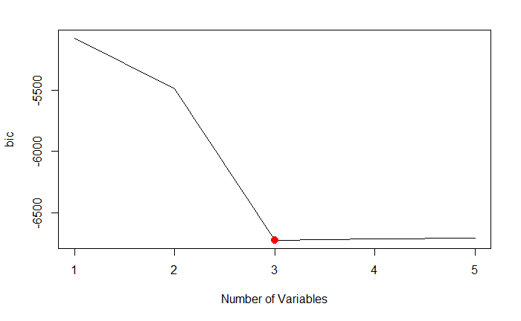
Best Subset Selection
Interested in minimizing bic, while minimizing the number of predictor variables.

Slide 4
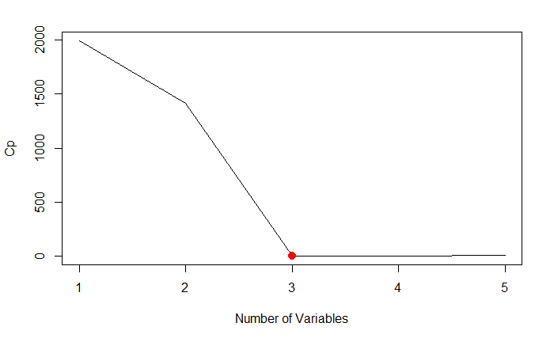
Best Subset Selection
Interested in minimizing Cp, while minimizing the number of predictor variables.

Slide 5
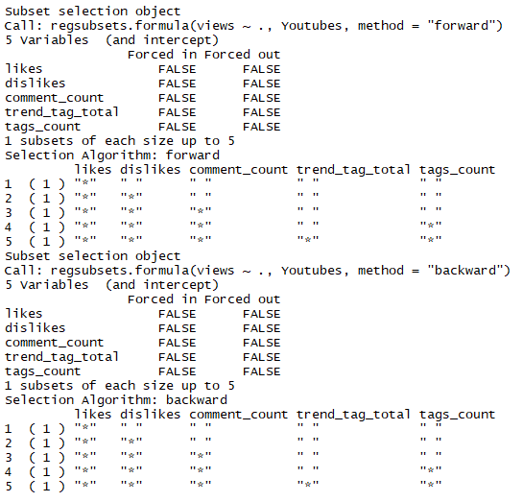
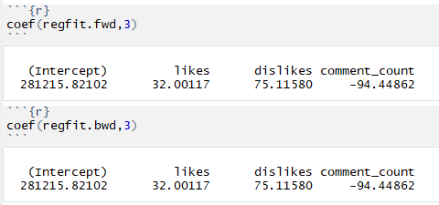
Forward and Backward Subset Selection

Slide 6
So now we know what variables we are going to use
Likes, dislikes, comment_count

Slide 7
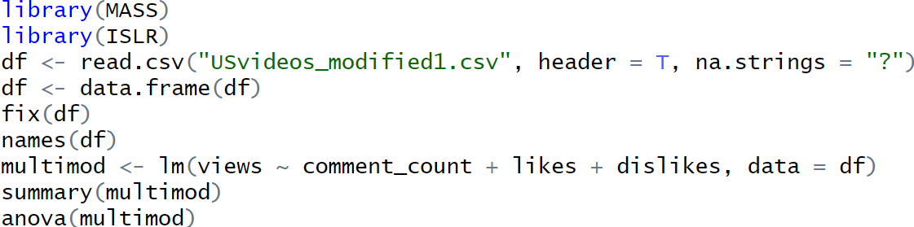
Multiple Linear Regression

Slide 8
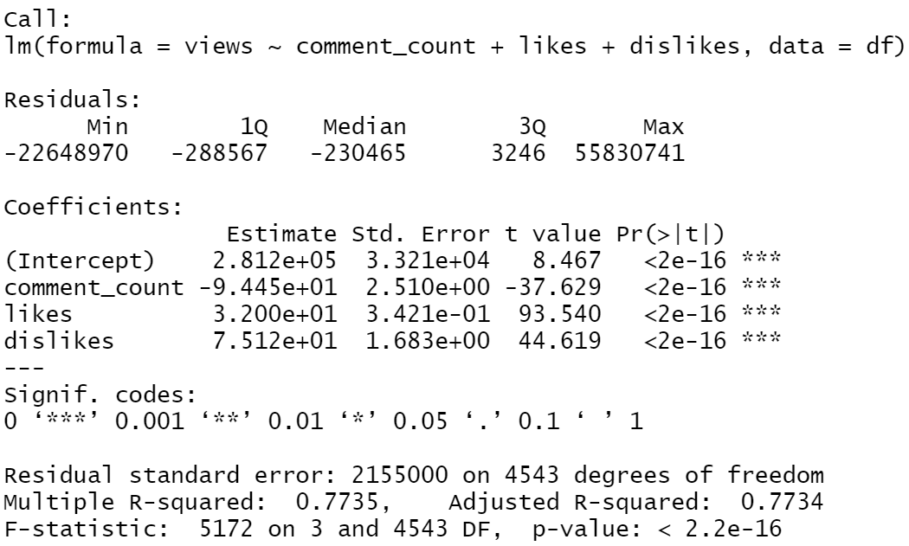
Results

Slide 9
Interpretation/Findings
MLR model: Y = -94.45 * x1 + 32 * x2 + 75.12 * x3 + 281200
Adjusted R^2 value is a measure of the accurate of your linear model.
Our adjusted r^2 value is .7735. This means 77.35% of the variability in our response (in this case views) is captured by our MLR model.
Note: We did not subset our data into training and testing. We will for our future project.

